Slide 1
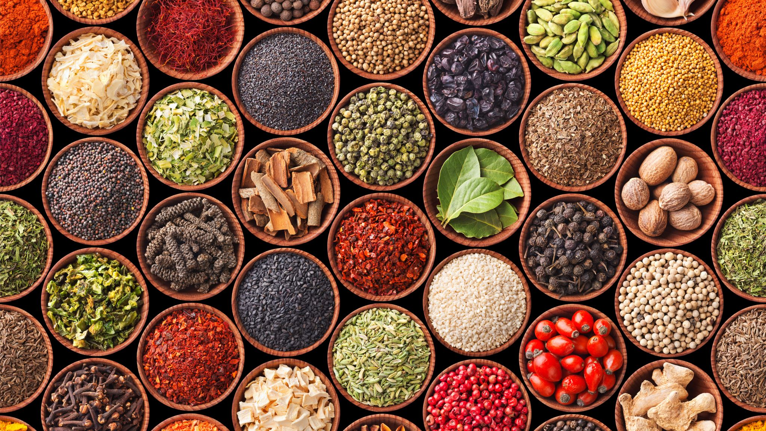
DSI Course: Climate Change, Food Systems and Planetary Health Theoretical constructs of nutrition and food systems July 23, 2024
Isabel Madzorera, ScD
Assistant Professor, University of California, Berkeley

Slide 2
Session overview
Nutrition Anthropometry
Dietary assessment
Food systems and Climate Change
Introduction

Slide 3
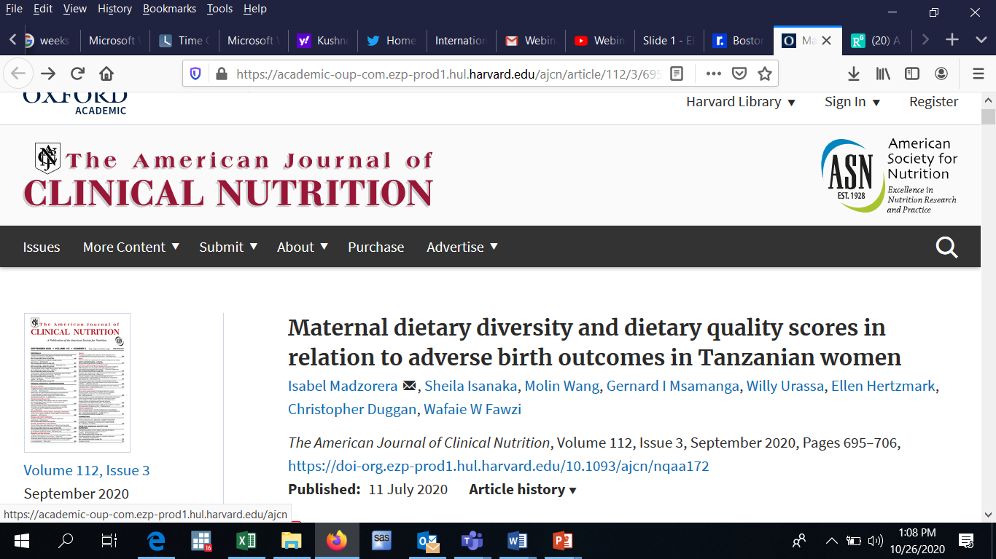
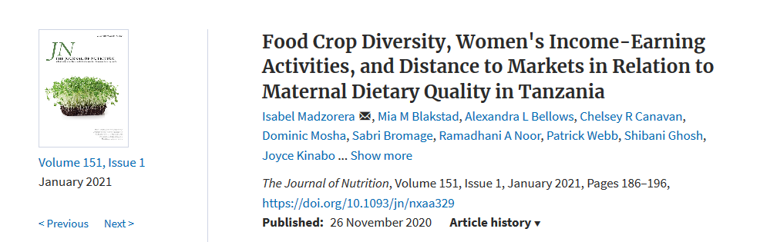
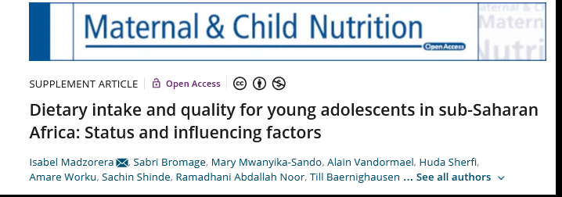

Slide 4
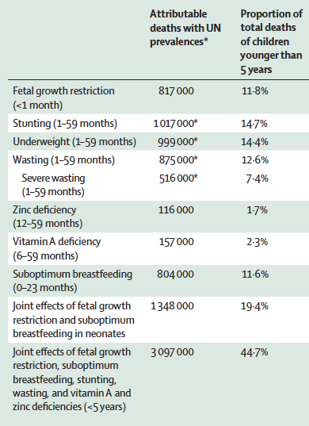
Introduction
Globally we face a triple burden of malnutrition
The coexistence of undernutrition, micronutrient deficiencies and overweight/obesity and related non-communicable diseases (NCDs).
45% of child deaths are due to undernutrition.
Citations: Black 2013

Slide 5
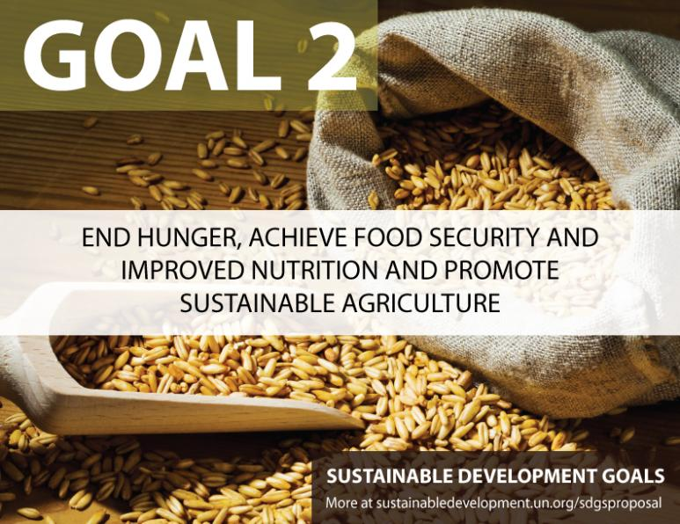

Big Picture:
Global commitments
Sustainable Development Goal #2
2.1: by 2030 end hunger and ensure access to safe, nutritious and sufficient food
2.2: by 2030 end all forms of malnutrition, including achieving global targets 2025 (address nutritional needs of adolescent girls, pregnant and lactating women, and older persons)
2.3: by 2030 double the agricultural productivity and the incomes of small-scale food farmers (especially women, family farmers, pastoralists)
2.4: by 2030 ensure sustainable food production systems and resilient agricultural practices (ecosystems, capacity for adaptation to climate change, soil quality)
2.5: by 2020 maintain genetic diversity of seeds, cultivated plants, farmed and domesticated animals and their related wild
Notes:
3 Key observations:
SDGs Goal No. 2: Nutrition is mentioned explicitly (unlike MDGs)
Sub section 2.1: Not limited to hunger and food quantity but also addresses nutrition quality
Subsection 2.2: includes WHA nutrition targets BUT only 2 out of 6; that is stunting and wasting in children under 5 years of age

Slide 6
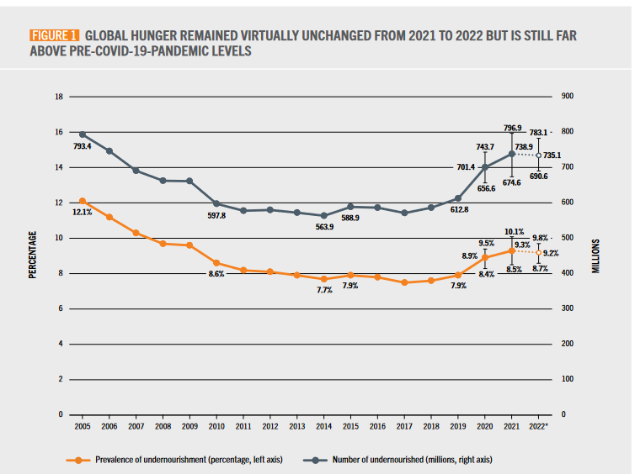
Prevalence of undernourishment in the world
Zero Hunger by 2030 (SDG Target 2.1)
Based on daily dietary energy consumption
Citations: SOFI 2022
Notes:
Based on food balance sheets. Estimates based on daily dietary energy consumption.
Reasons why hunger has increased :
Weak, stagnant or deteriorating economic conditions are underlying causes of increasing poverty and undernourishment.; Economic slowdowns and downturns
Rising consumer food prices during the pandemic
war in Ukraine is disrupting supply chains and further affecting prices of grain, fertilizer and energy.

Slide 7
Question 1:
What region has the highest number of undernourished people?
Latin America and the Caribbean
Africa
Asia

Slide 8
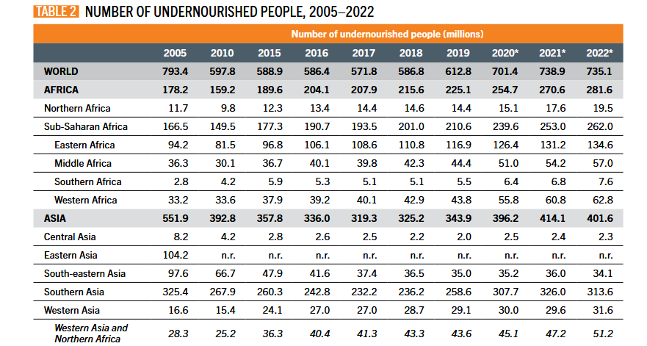
Global prevalence of undernourishment
Prevalence of undernourishment has been increasing (and COVID-19 and the war in Ukraine exacerbated this)
Other factors: population growth, urbanization, poorly performing food systems, climate change
Source: SOFI 2023
8

Slide 9
Triple burden of malnutrition in Africa
45% of child deaths are due to malnutrition.
63.1 million children stunted (30%)
12.2 million children wasted
Increased risk of non-communicable diseases (NCDs) – e.g. diabetes, hypertension, diet related cancers in later life
Anemia: 30% of female & 20% of male adolescents in LMICs
41% anemia in women of reproductive age
10.2 million children overweight
(Source: SOFI 2021, UNICEF 2023, WB)
Notes:
Vs. 21.3% in Asia

Slide 10
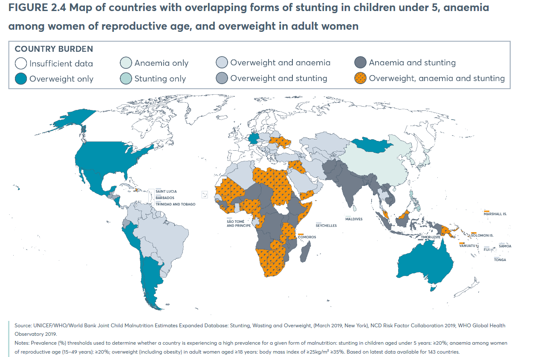
Multiple and coexisting forms of malnutrition
Stunting in children, anemia and overweight in women
Citations: GNR 2020

Slide 11
Session overview
Nutrition Anthropometry
Dietary assessment
Food systems and climate change
Introduction

Slide 12
Why assess nutritional status?
Identify individuals at risk of poor nutrition
When establishing baseline levels of nutrition in populations
e.g. what proportion of children under 5 years living in Kenya are malnourished (and therefore what intervention should be employed)?
When studying the role nutrition plays in health and disease
e.g. Does high intake of calcium versus low intake during pregnancy change the risk of preterm birth?
When evaluating the impacts of other factors on nutrition and health
e.g. Does climate change impact child stunting and wasting in Ethiopia?

Slide 13
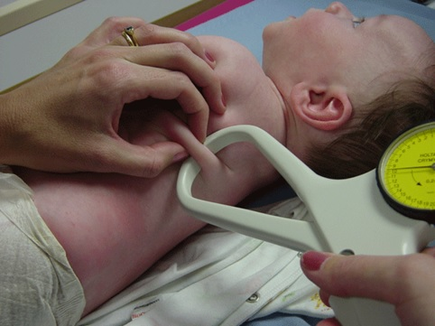
Types of nutrition assessment
Anthropometric assessment
Growth anthropometry
Biochemical assessment
Clinical assessment
Dietary assessment
Citations: www.mrc-epid.cam.ac.uk
Notes:
Skinfold calipers to assess body fat composition

Slide 14
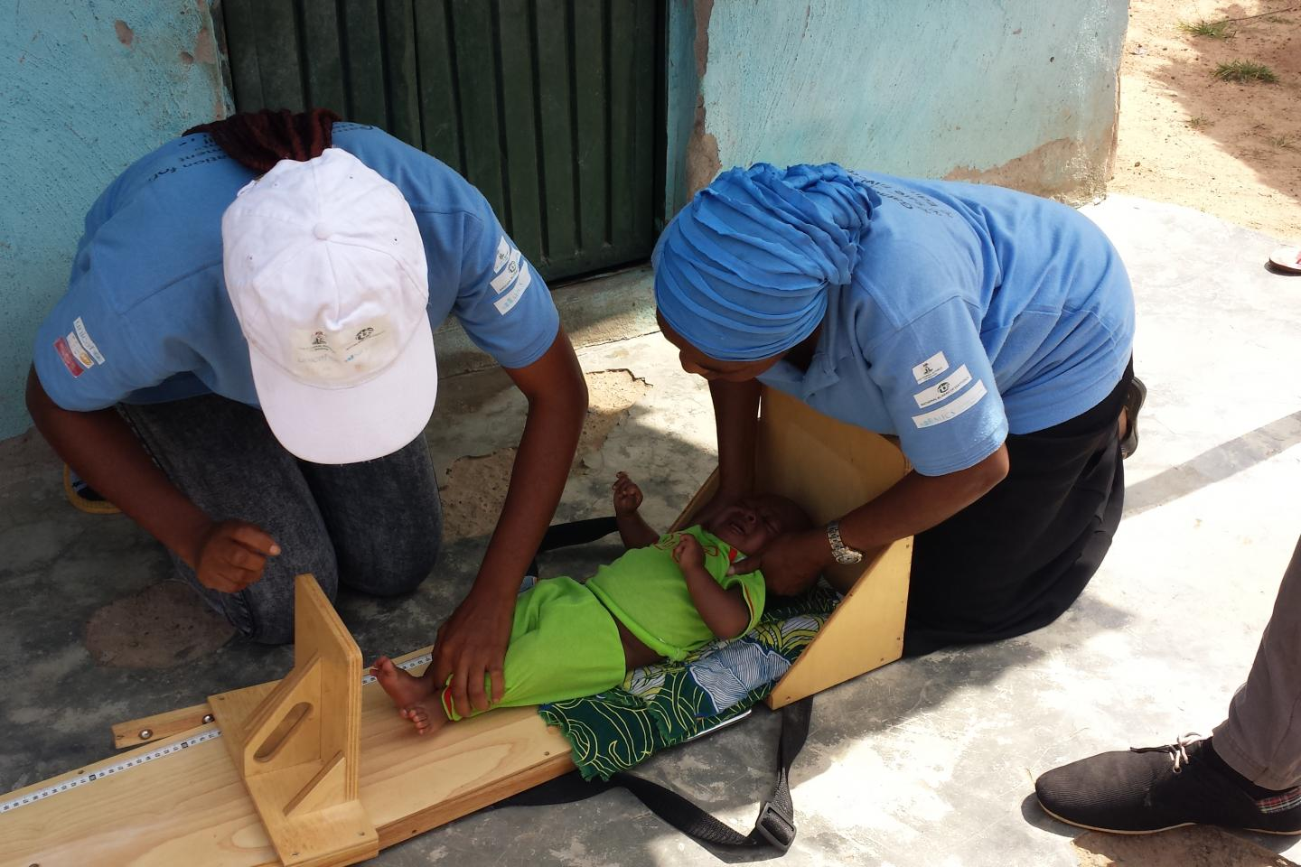
Anthropometric measures
Definition: the study of human body measurements e.g muscle, bone and adipose tissue
Common measures:
Height (or length for children <2 years)
Weight
Mid-upper arm circumference
Waist circumference
Skinfold thickness
Head circumference (for newborns)
Body mass index (BMI)
Show influence of diet in the past on growth
Measurements are simple, quick and inexpensive.
Non-invasive
Citations: de Onis 2006,

Slide 15
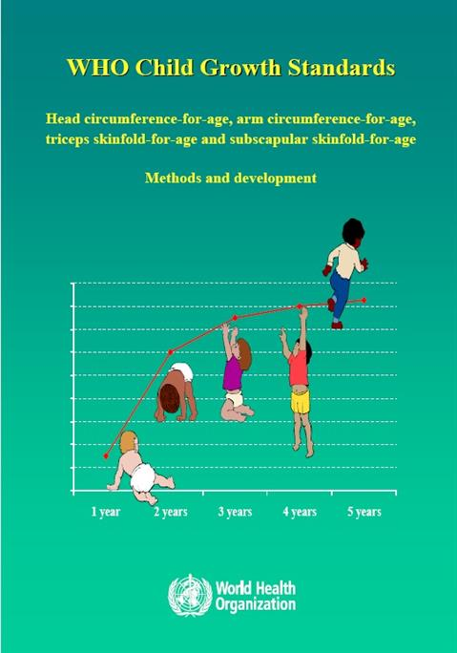
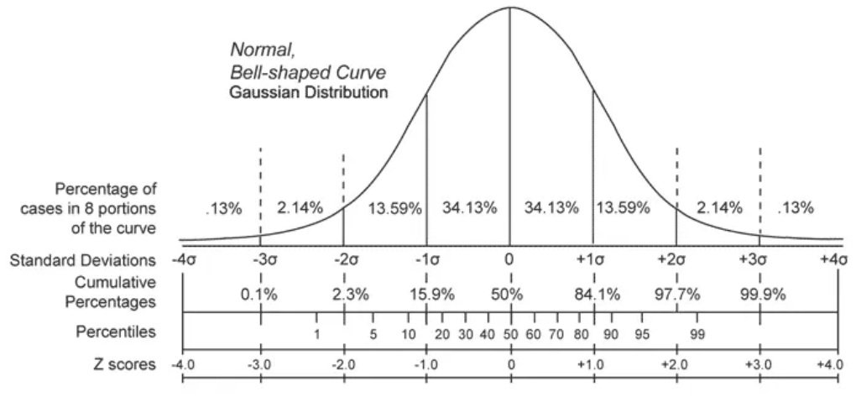
Measuring child growth
< -2 standard deviations = undernutrition
Based on WHO growth standards from 2006 : Davis, USA; Muscat, Oman; Oslo, Norway; and Pelotas, Brazil; Accra, Ghana and South Delhi, India
Citations: WHO; de Onis, 2016

Slide 16
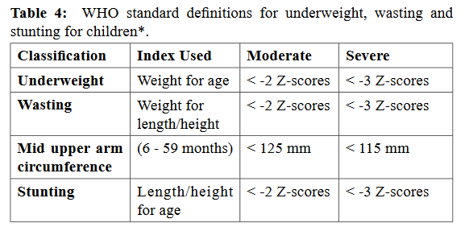
Child anthropometry
Why does it matter?
Anthropometric measures are sensitive to nutritional intakes
Associations between anthropometric measures and morbidity/mortality
Can be used to evaluate both over and undernutrition
Citations: WHO, UNICEF 2020

Slide 17
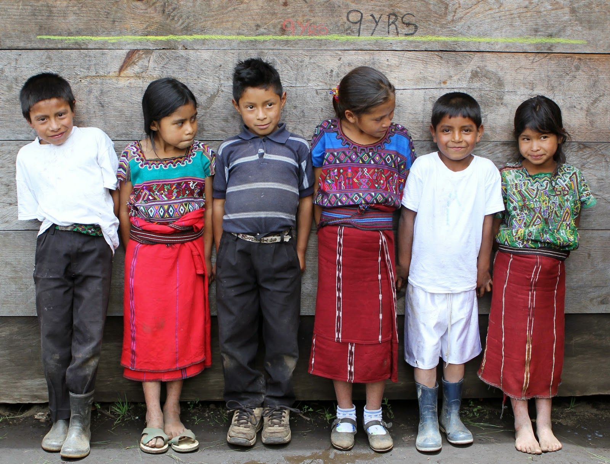
Stunting

Slide 18
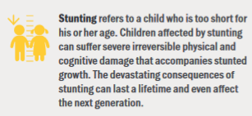
Stunting
Definition: Impaired linear growth in children due to chronic undernutrition.
Causes:
Poor maternal diet and infection during gestation.
Poor breastfeeding and complementary feeding practices.
Repeated infection, and inadequate psychosocial stimulation
Poor water, hygiene and sanitation practices
Consequences:
Increased morbidity and mortality - infections eg pneumonia, diarrhoea
Poor cognitive and physical development, low educational performance
Low adult wages, lost productivity
Increased risk of overweight/obesity later in childhood
Increased risk of nutrition-related chronic diseases in adult life
Citations: Prendergast 2014

Slide 19
Question 2:
What world region has the greatest number of stunted children?
South America
Sub-Saharan Africa
Southern Asia
North Africa

Slide 20
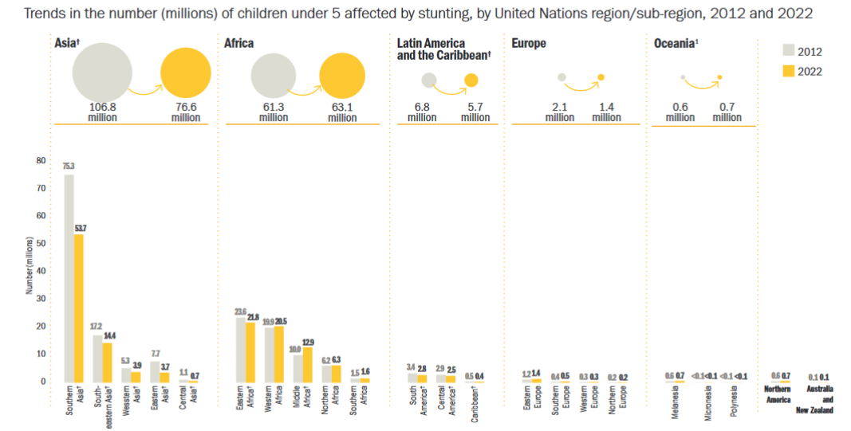
Prevalence:
Africa: 30%
Asia: 21%
Despite declining prevalence, the absolute number of children with stunting has increased in SSA (Central Africa)

Slide 21
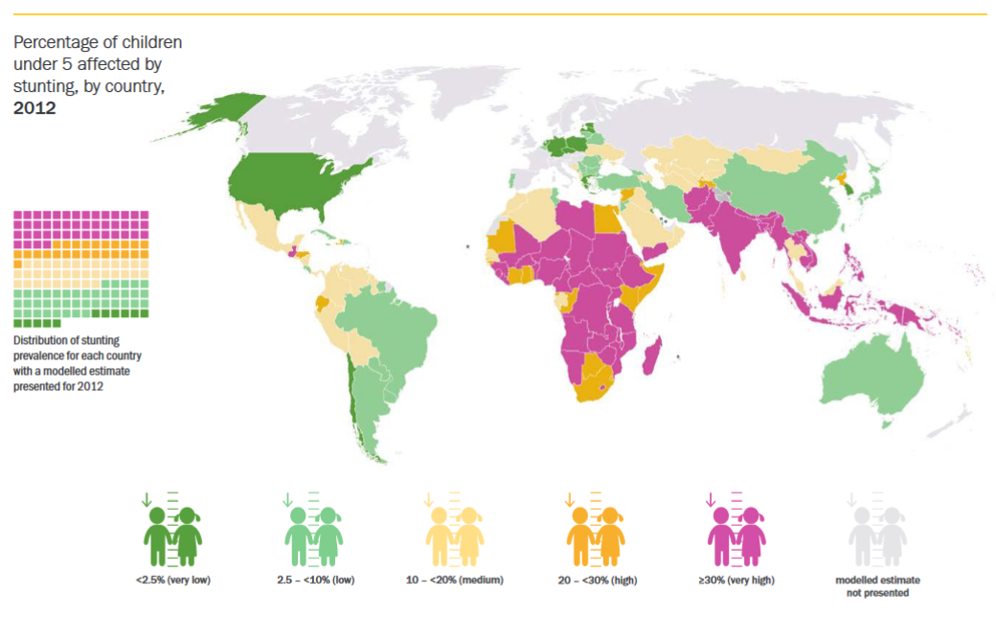
Global stunting burden (< 5y) in 2022
Citations: UNICEF/WHO/World Bank 2023
Notes:
Typo

Slide 22
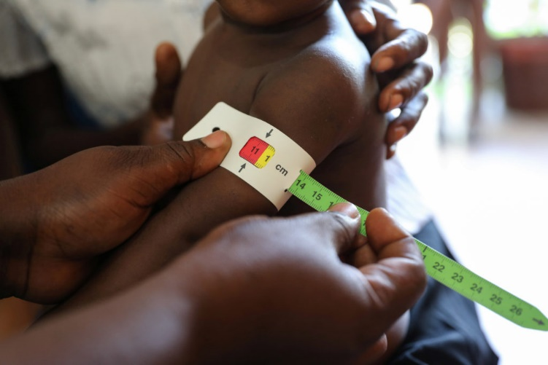
Anthropometry: Do you think this child is malnourished?
Mid-upper arm circumference (MUAC)
Easily measured in emergency settings
Exact age not needed
Inexpensive
Predicts mortality
Mid-upper arm circumference

Slide 23
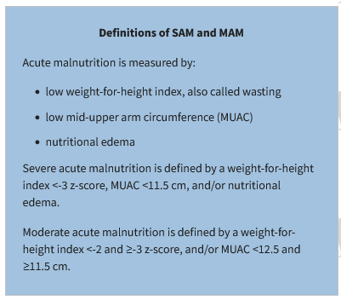
Reminder: Severe acute malnutrition
Pictures : UNICEF

Slide 24
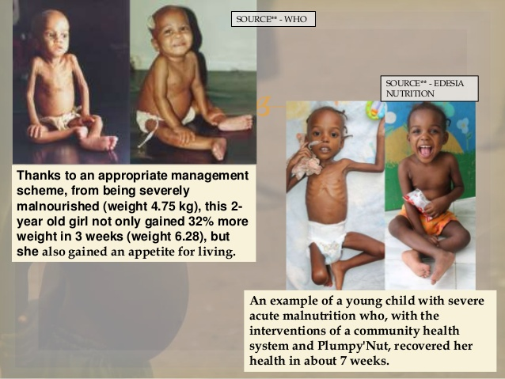
Wasting
Causes:
Inadequate caloric intake (macronutrients e.g. calories, protein – previously classified as, marasmus, kwashiorkor)
poor dietary intake, poor absorption of nutrients eg diarrhea
Inadequate caring and feeding practices
e.g. exclusive breastfeeding or low-quality complementary food
Repeated infections
Poor access to safe water, hygiene and sanitation services
Occurs more frequently in droughts or conflict situations
Citations: WHO 2013, Manary 2008

Slide 25
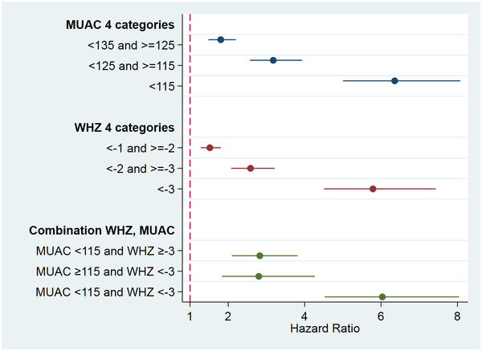

Pooled study on odds of mortality: Democratic Republic of the Congo (DRC), Senegal and Nepal: Children are 6X more likely to die
Wasting
Consequences:
Increased odds of mortality
Mortality from diarrhea, pneumonia, malaria, measles
Treatment & Prevention:
Therapeutic feeding
Ready to eat therapeutic foods (RUTFs) – lipid and micronutrient based supplements
Peanut based paste e.g., Plumpynut
Inpatient treatment with special milk formulations
Prevention & treatment for infections such as diarrhea
e.g. using zinc & oral rehydration solution
Citations: Schwinger 2019, Black 2008; WHO 2013, Photo: UNICEF

Slide 26
Question 3:
What world region has the greatest prevalence of wasting in children?
South America
Sub-Saharan Africa
South Asia
North Africa

Slide 27
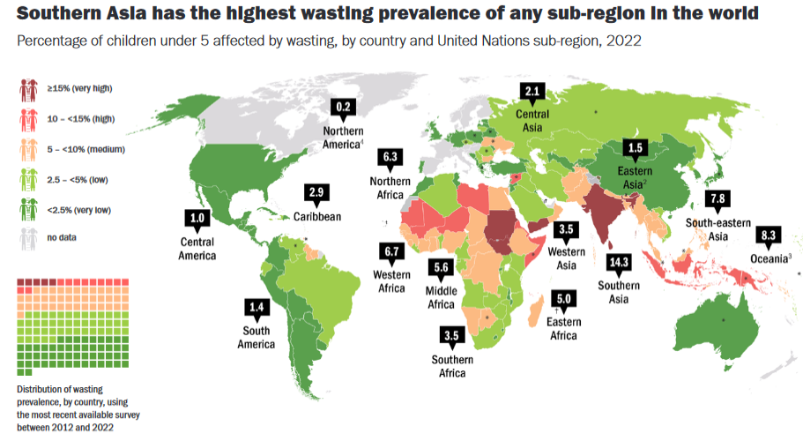
Global wasting burden (< 5y)
Citations: UNICEF/WHO/World Bank 2023

Slide 28
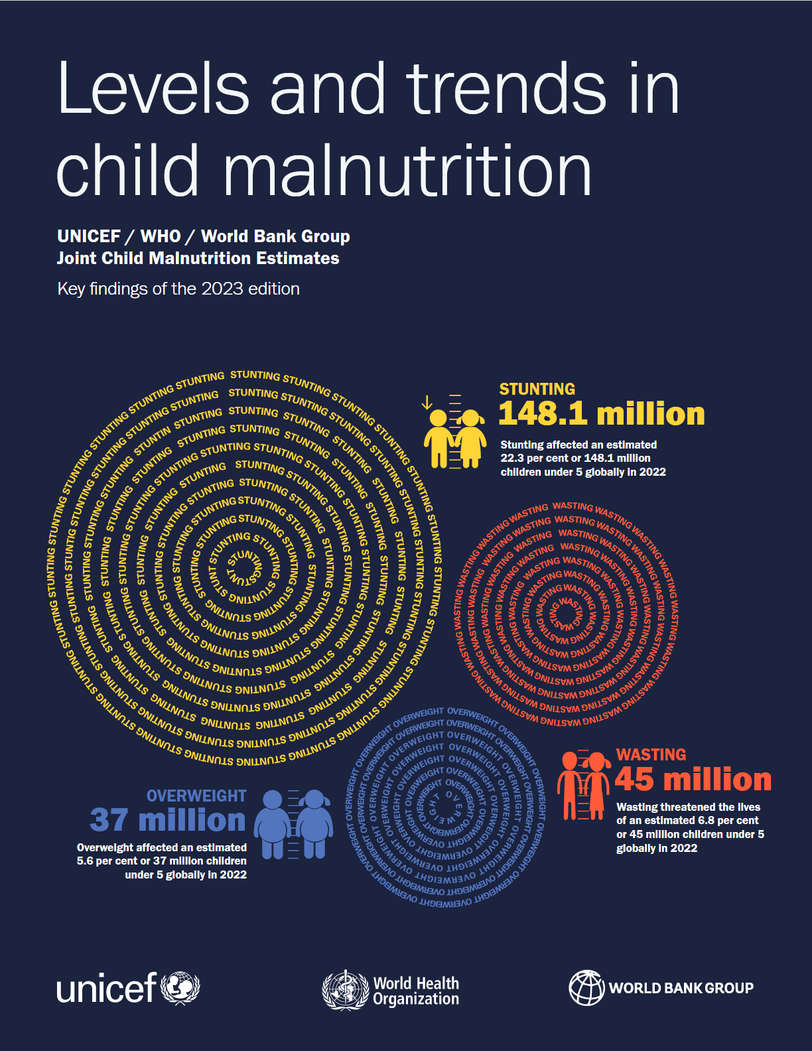
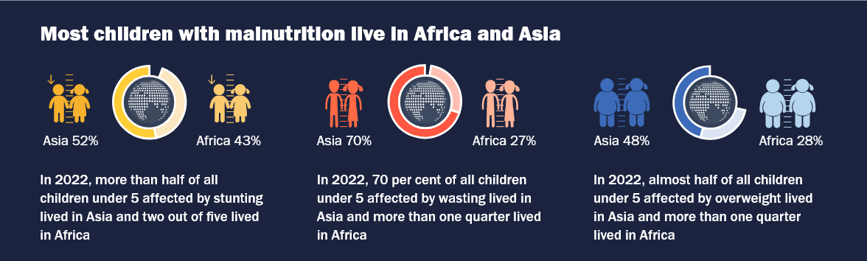

Slide 29
Measuring overweight and obesity
CDC definitions for adult overweight and obesity, WHO definitions for all else.
 | Children <5 y | Children 5-19 y |  | Adults
Underweight |  |  |  | BMI<18.5kg/m²
Overweight | WHZ>2 | WHZ>1 |  | 25 ≤ BMI < 30 kg/m²
 |  |  |  | (Class I) 30 ≤ BMI < 35 kg/m²
Obese | WHZ>3 | WHZ>2 |  | (Class II) 35 ≤ BMI < 39 kg/m²
 |  |  |  | (Class III) BMI ≥ 40 kg/m²
Body mass Index (BMI): weight(kg)/[height(m)]²
Citations: WHO 2016; CDC 2016

Slide 30
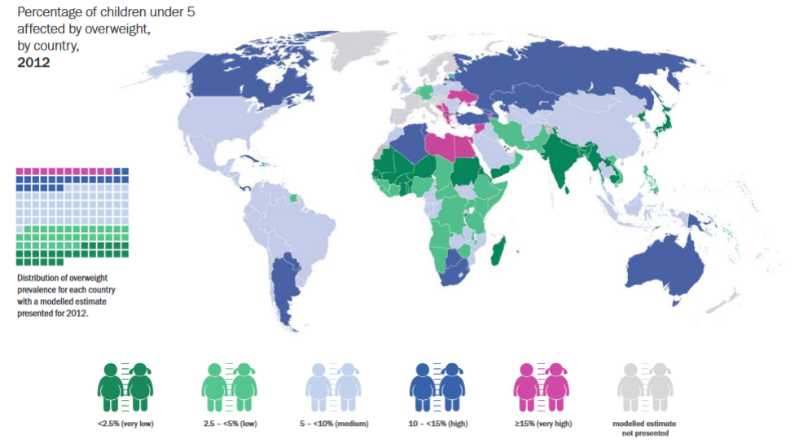
Global overweight burden children (< 5y)
Citations: UNICEF/WHO/World Bank 2023

Slide 31
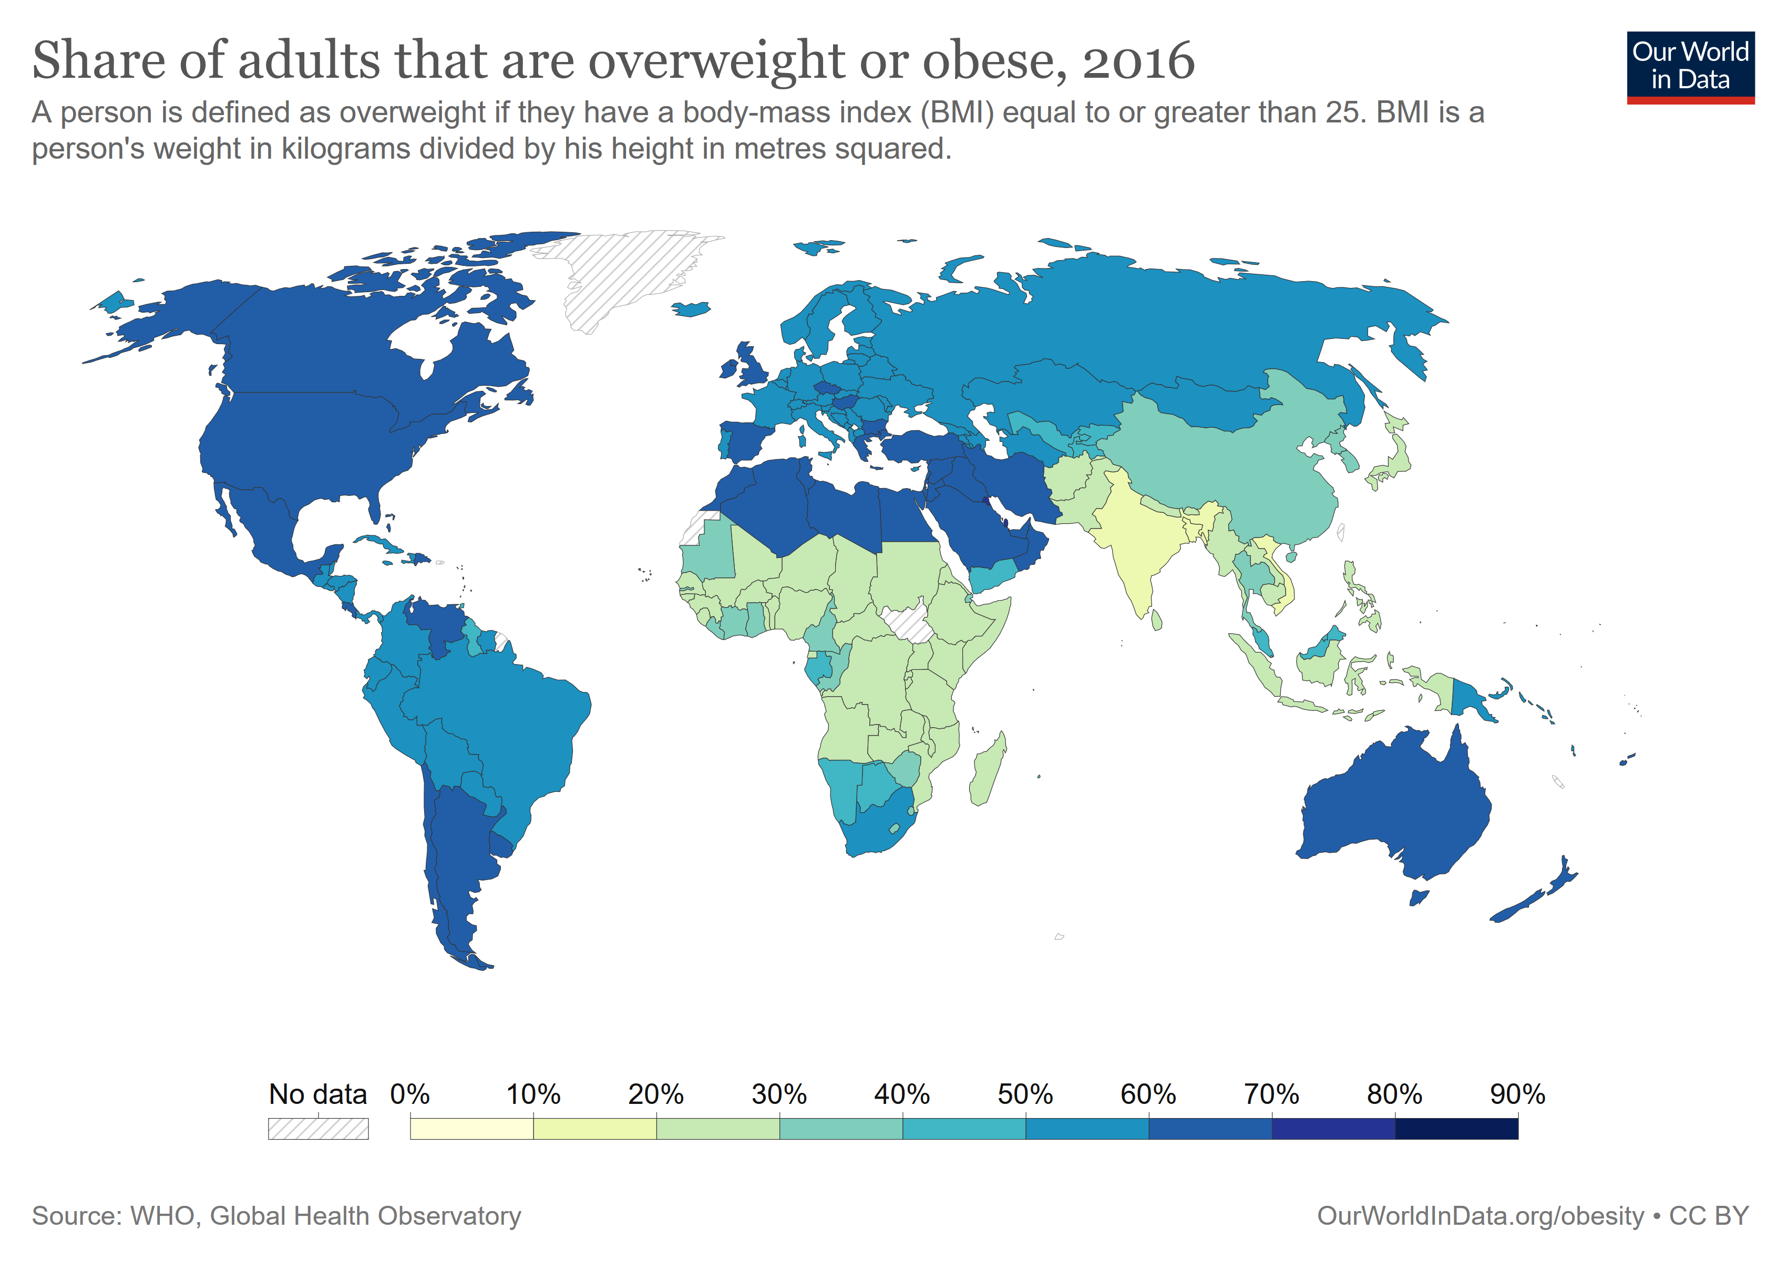
Notes:
Based on food balance sheets. Estimates based on daily dietary energy consumption.
Reasons why hunger has increased :
Weak, stagnant or deteriorating economic conditions are underlying causes of increasing poverty and undernourishment.; Economic slowdowns and downturns
Rising consumer food prices during the pandemic
war in Ukraine is disrupting supply chains and further affecting prices of grain, fertilizer and energy.

Slide 32
Overweight/Obesity
Proxy for metabolic syndrome
Causes:
Lifestyle factors, e.g. low quality diets, low physical activity, irregular sleep.
Genetics and diseases (e.g. hypothyroidism)
Medications
Unhealthy food environments eg food deserts
Consequences:
Increased risk of morbidity and mortality
Associated with diet-related NCDs e.g. type 2 diabetes mellitus, coronary heart disease and stroke, some cancers etc
Adverse psychosocial effects (e.g. depression).
Citations: WHO 2016c; Roberto 2015

Slide 33
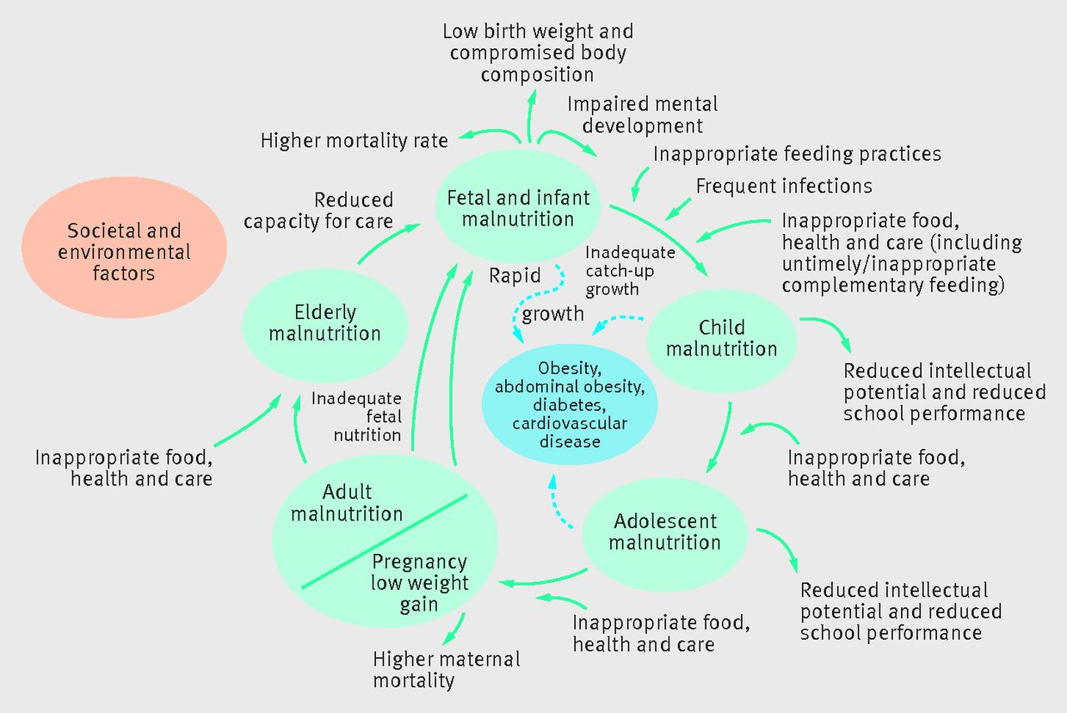

Nutrition through the life course - proposed causal links
Francesco Branca et al. BMJ 2015;351:bmj.h4173
Notes:
Fig Nutrition through the life course—proposed causal links13

Slide 34
Session overview
Nutrition Anthropometry
Dietary assessment
Food Systems and Climate change
Introduction

Slide 35
Nutrition epidemiology
Definition: examines dietary or nutritional factors in relation to disease occurrence in populations.
Findings from nutritional epidemiology used in guiding dietary recommendations e.g. for prevention of cardiovascular disease, hypertension, diabetes, cancer and other diseases.
Epidemiological methods have been used to study the relationship between diet and disease
Citations: McCullough and Giovannucci, 2006

Slide 36

Nutrition assessment methods: Dietary assessment
Diet record
24Hr dietary recall
Food frequency questionnaire

Slide 37
24-hour dietary recall
Dietary assessment gold standard: diet record
You are asked to record and weigh all the foods you eat and drink over the next 7 days. What challenges can you anticipate?
Alternatives:
24 HR recall
Objective
Measure current average diet of a group or population
Assesses mean nutrient intake
Compare intake with recommendations. Often used in field studies globally
Structure
Recall and report food and beverage intake in preceding 24 hours
Administered by trained interviewer.
Typically includes an estimate of quantities consumed

Slide 38
Class activity – 3 mins
Divide the class into pairs
Select 1 person in your pair to be a respondent and the other person will be the interviewer
Interviewer: Ask your partner to detail EVERYTHING they ate between 7am yesterday and 7 am this morning.
Probe for additional foods and beverages
Once you have completed the 24-hour recall, make a list of the strengths and weaknesses of this approach.
Report back to the class on what strengths and weaknesses you noticed.
Notes:
Assign participants into breakout rooms for 5 minutes
Include a report-back before we go to the next slide

Slide 39

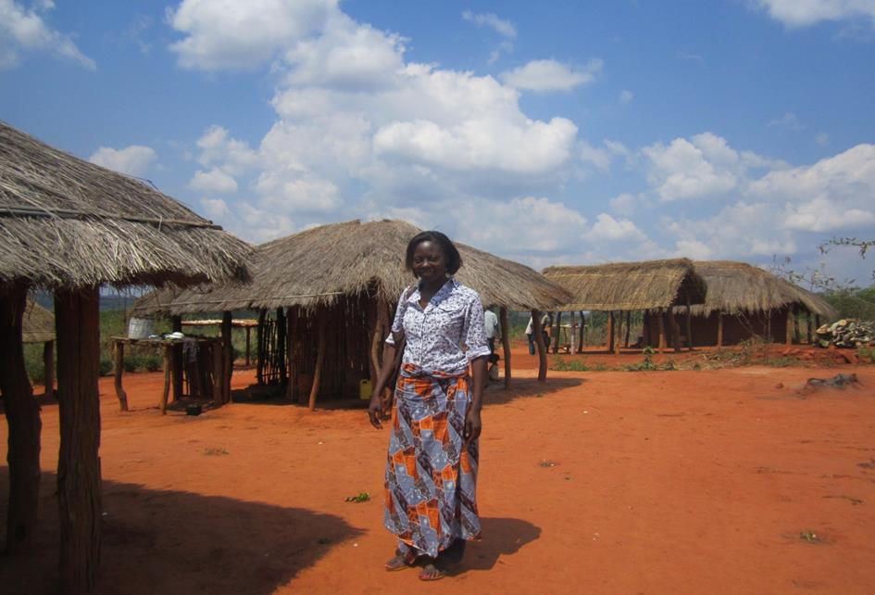
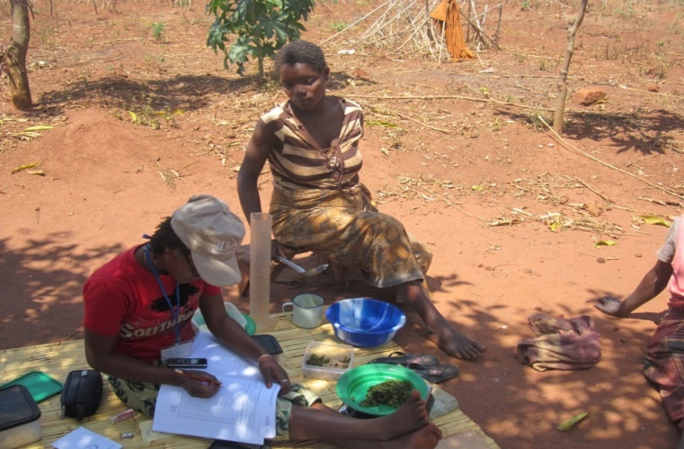
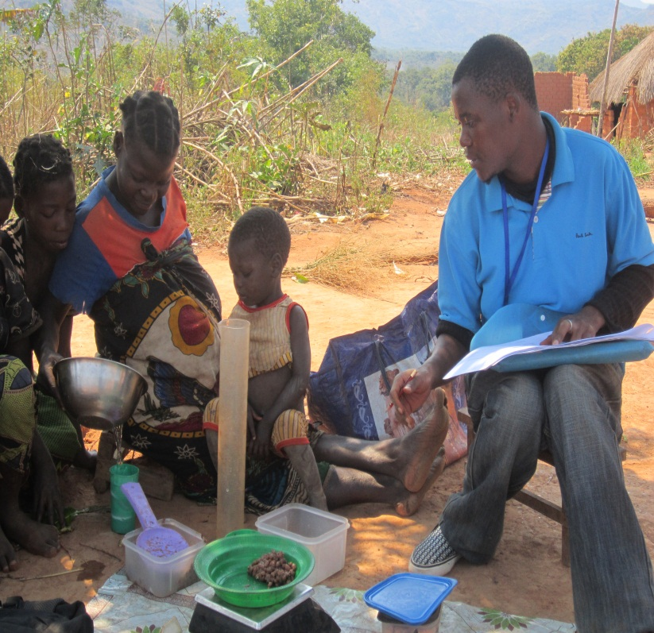
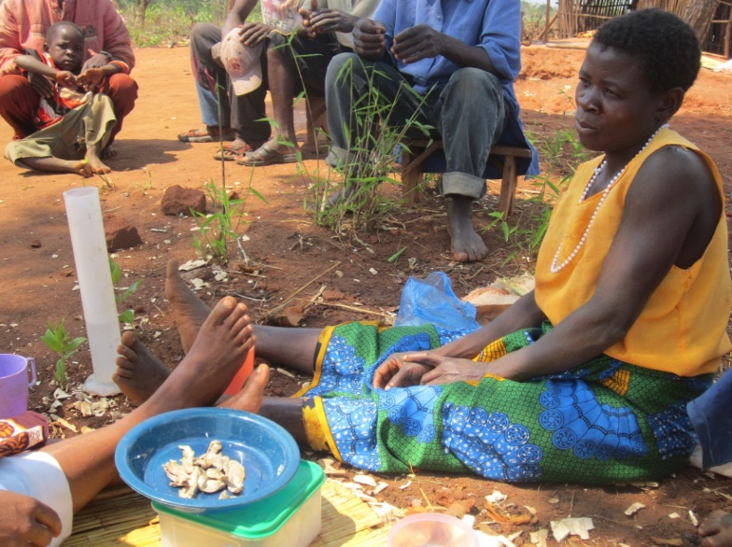
My journey into global nutrition

Slide 40
24-hour recall
Strengths
Quick and easy to administer Can be administered in person, on the phone, etc. Low respondent burden Literacy is not required for respondent No restrictions on foods that can be reported Long-term memory not required. Does no interfere with eating behavior.
 | Weaknesses
 | Requires a well-trained interviewer. Relies on accurate memory. Age, memory Can result in recall error, e.g. recall bias Subject may selectively recall “good foods” foods and exclude those considered “bad” Quantification of portion sizes requires portion size aids Subject to day to day variation Multiple 24Hr recalls needed to represent the usual diet.

Slide 41
2. Food frequency questionnaire (FFQ)
Objective
Measure usual intake, i.e. long-term diet
Measure individual nutrient and food intake
Relative ranking of intake is priority
Structure
Food list includes foods that are consumed reasonably often, have substantial nutrient content, or those whose intake varies between subjects.
Record the frequency of consumption of the listed foods and beverages, and portion sizes
Specific recall period eg 7 days or 30 days
Can be administered by interviewers (eg LMICs) or self-administered

Slide 42
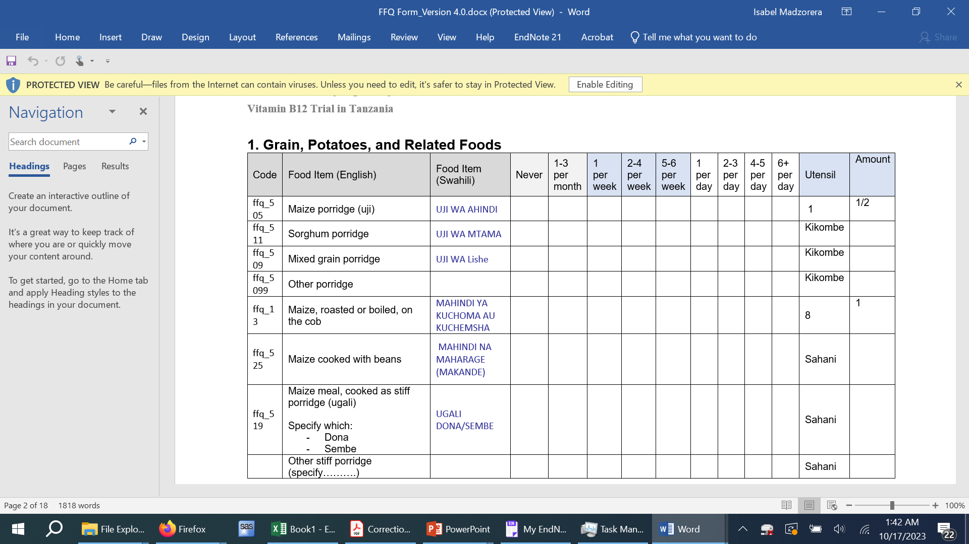

Food frequency questionnaire (FFQ) example

Slide 43
Food frequency questionnaire
Strengths
Relatively inexpensive and easy to administer Can be self-administered and computer processed Useful for large epidemiologic studies, measures usual intake Compares people with high vs low intake of nutrients/dietary patterns Well-established validity
 | Weaknesses
 | Recall of foods may be inaccurate – recall bias Often not transferrable across cultures/populations, e.g. may miss important foods from the list Not ideal for estimating absolute intake E.g. may underestimate energy intake Requires literacy if self administered Tedious for the participant

Slide 44
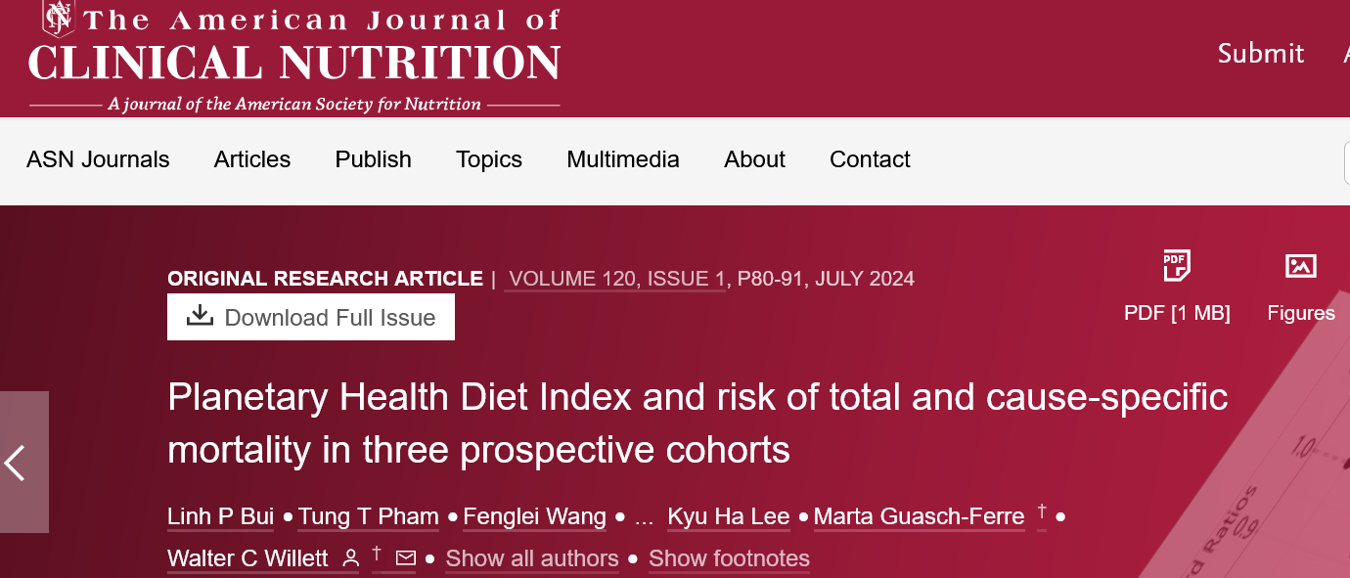
Uses of dietary data
Findings from 24HR recall or FFQ converted to nutrient intake using local food composition tables
Develop metrics of diet quality and diversity eg,
a posterori (e.g. from factor analysis)
a priori
Diet diversity: Minimum Dietary Diversity Score for Women (MDDW)
Diet quality: Global Diet Quality Score (GDQS), Planetary Health Diet

Slide 45
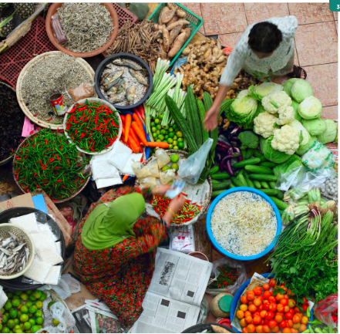
Globally accepted measures of diet quality for women, children or adolescents?
1. Dietary diversity as a proxy measure of diet quality in LMICs?
2. Measurement [Alkerwi et al, 2014; Trijsburg et al, 2019]
nutrient adequacy/food variety or food diversity
moderation - saturated fat, sodium, sugar, nutrients associated with excess disease risk
balance - energy-yielding macronutrients
3. Gaps:
Varying definitions
Updated tools for adults need validation in LMICs
No validated tools and metrics– adolescents, children, need to adopt/adapt and validate tools in LMICs
Source: EAT-Lancet Commission, 2020

Slide 46
Session overview
Nutrition Anthropometry
Dietary assessment
Food Systems and Climate change
Introduction

Slide 47
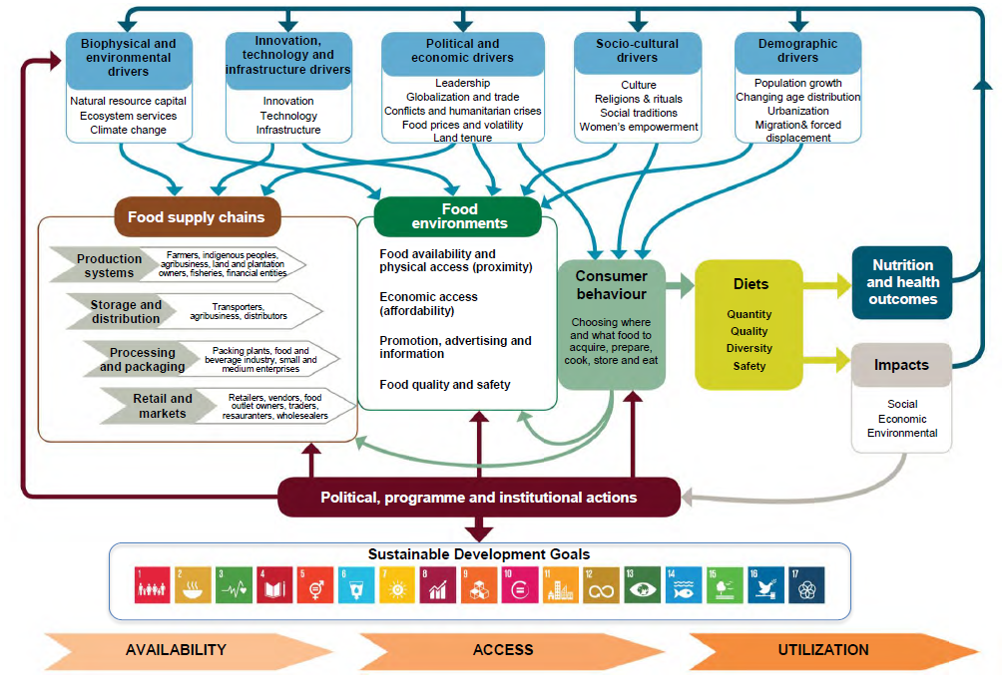
Food systems are complex
Food systems: Include all the elements (environment, people, inputs, processes, infrastructures, institutions) and activities that relate to the production, processing, distribution, preparation and consumption of food, and the outputs of these activities, including socio-economic and environmental outcomes (HPLE, 2017)

Slide 48
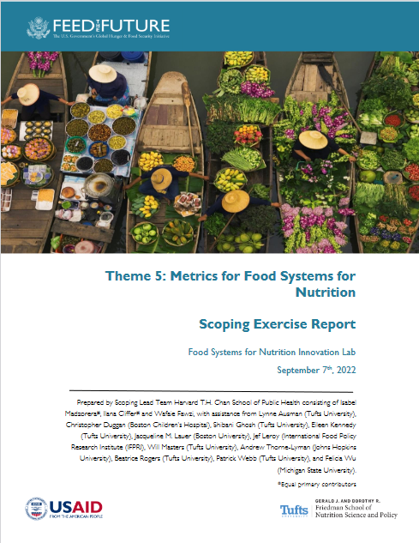
Women & children in LMICs (Africa, Asia, Latin America) have poor-quality diets
Globally food systems are failing to deliver healthy diets
Limited diversity (fruits, vegetables; animal foods); plant-based; poor bioavailability (Arimond et al, 2010; Torheim et al, 2010)
3 Billion people cannot afford a healthy diet, $3.75/person/day (Herforth et al, 2020; SOFI Report)
Diet quality: 85% of the population in SSA cannot afford a healthy diet (SOFI report), with women and children most affected
Globally sub-optimal diets - #1 risk factor for mortality [Murray et al, 2020]
11M deaths/yr attributed to dietary risk factors (Afshin et al (GBD), 2019)
Diet-related chronic diseases: obesity, diabetes, hypertension, cardiovascular diseases, diet-related cancers
Nutrition and dietary transition
Food value chains and diets rapidly shifting in LMICs - processed, refined, fast foods; decreased physical activity (Popkin et al, 2014)
Source: USAID 2022

Slide 49
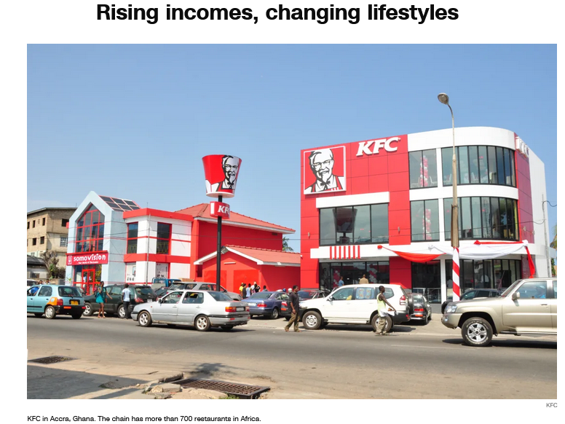

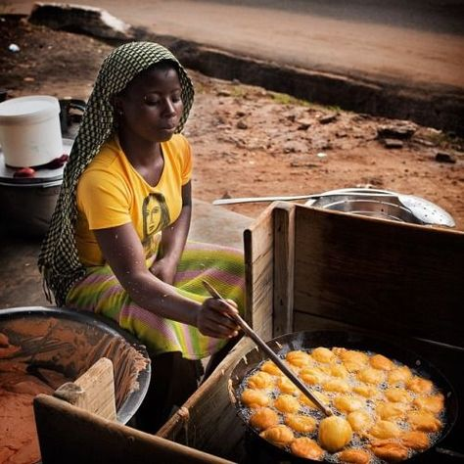


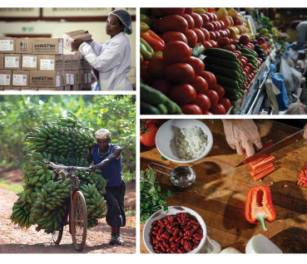
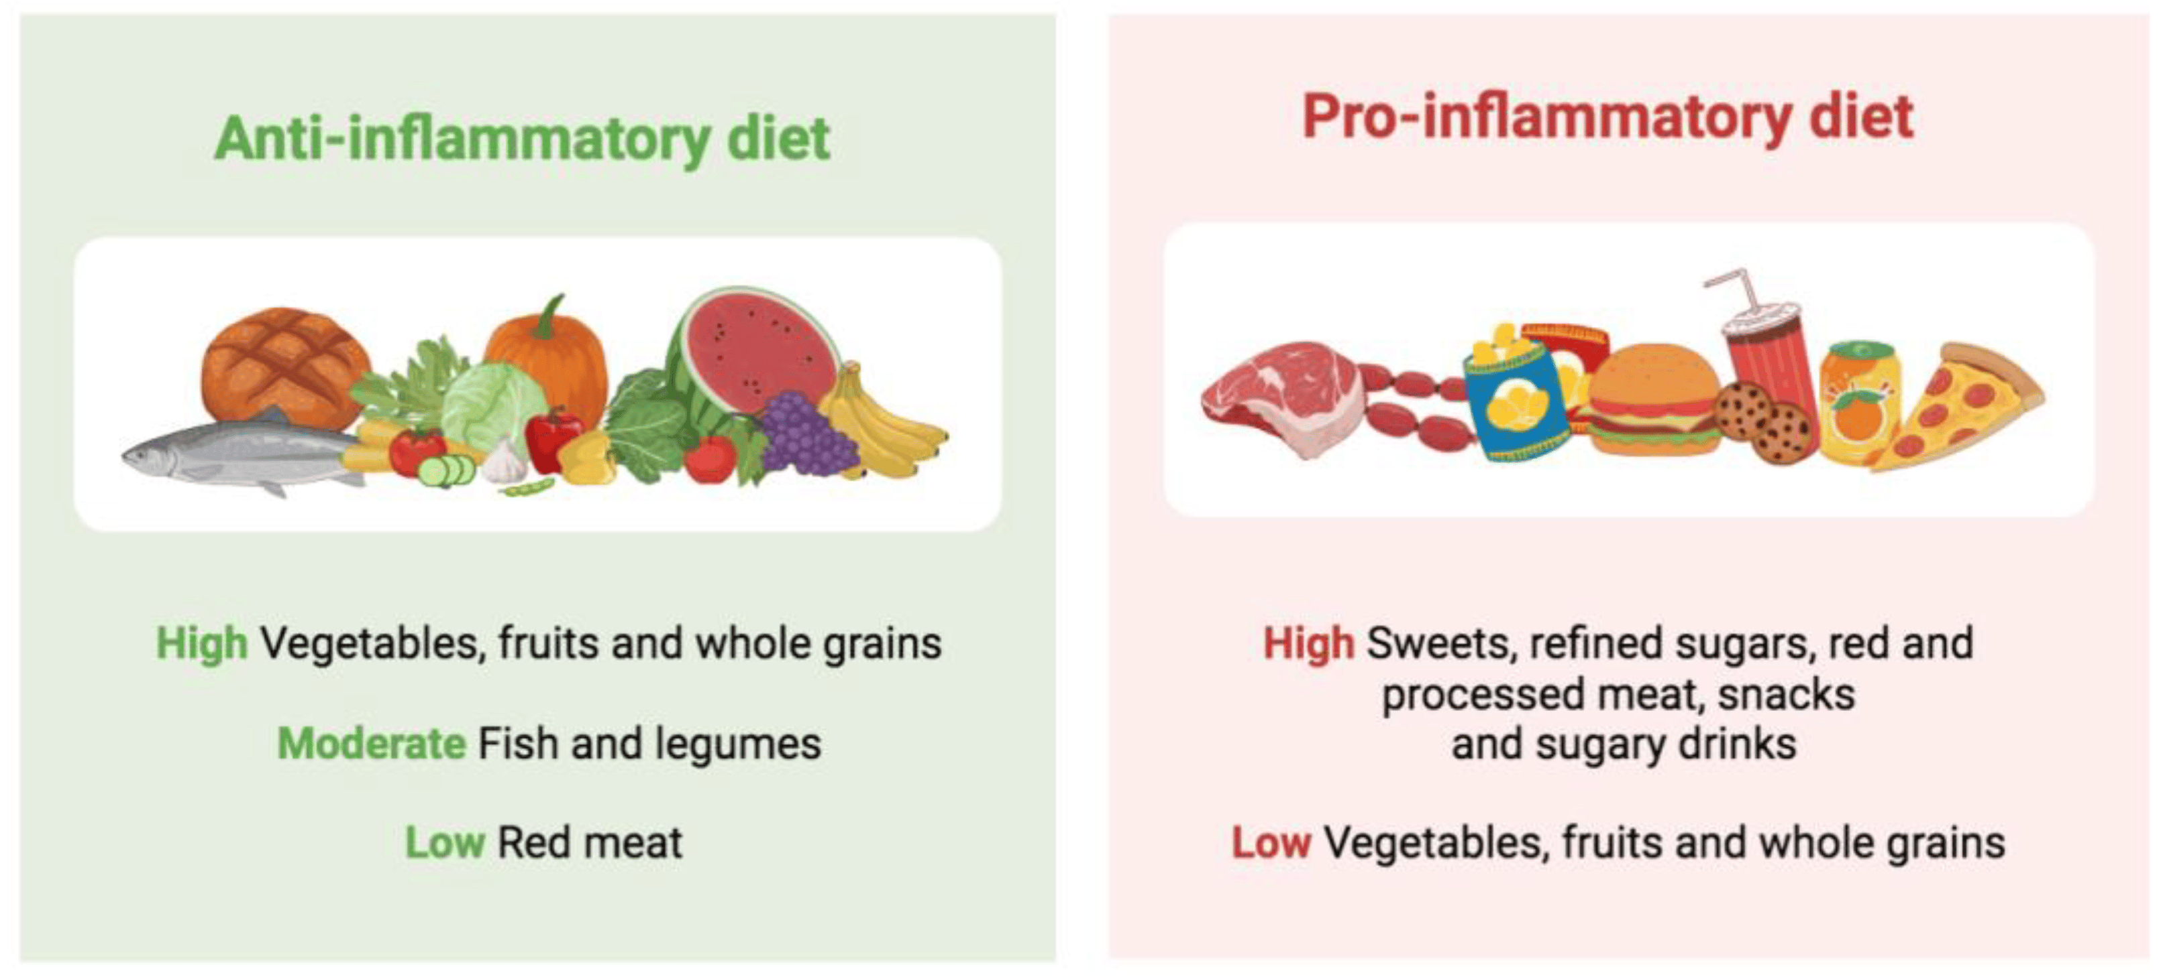

Credit: CNN
Source: FAO
Sub-optimal food systems

Slide 50
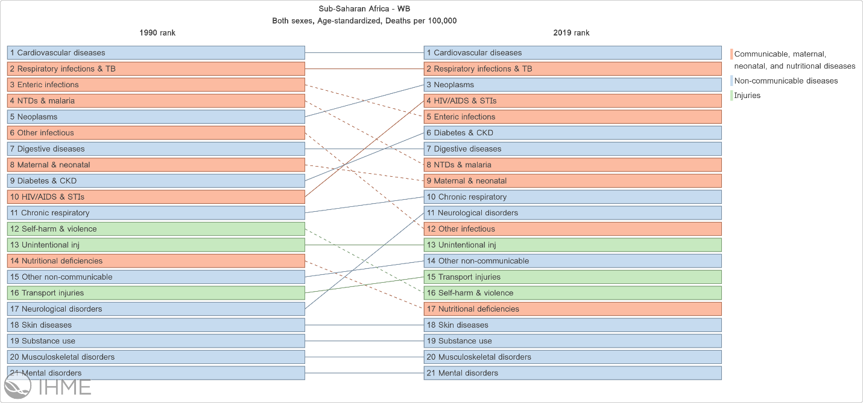
Global burden of disease (GBD Studies) in SSA
Poor diet quality linked to NCDs
Obesity, type 2 diabetes, hypertension, cardiovascular disease, and diet-related cancers.
Very limited studies in Africa on diets and NCDs
Vegetables, fruits, whole grains and fibre, legumes, fish, and chicken that seem to be protective against NCDs.
Sugar-sweetened beverages, refined grains e.g. white rice, ultra-processed foods, fried foods, trans-fat, excessive animal products e.g. processed and red meats, refined and fast foods, and Western-style diets.

Slide 51
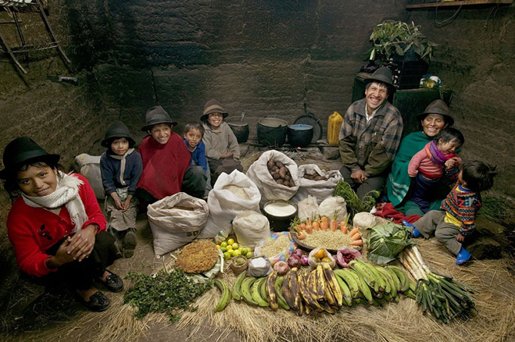
Food systems, diets and nutrition
Bidirectional relationship between agriculture and nutritional status
Agriculture and food systems are important determinants of nutrition and health
Nutrition status is also a factor in agriculture productivity
Food systems affect human health through their influence on food environments and diet quality
Understanding of linkages between agriculture/food systems, diets, nutrition and health, and policy actions to address them is limited
Ecuador, What the World Eats (Peter Menzel)
Notes:
https://www.anh-academy.org/sites/default/files/FEWG_TechnicalBrief_low.pdf

Slide 52
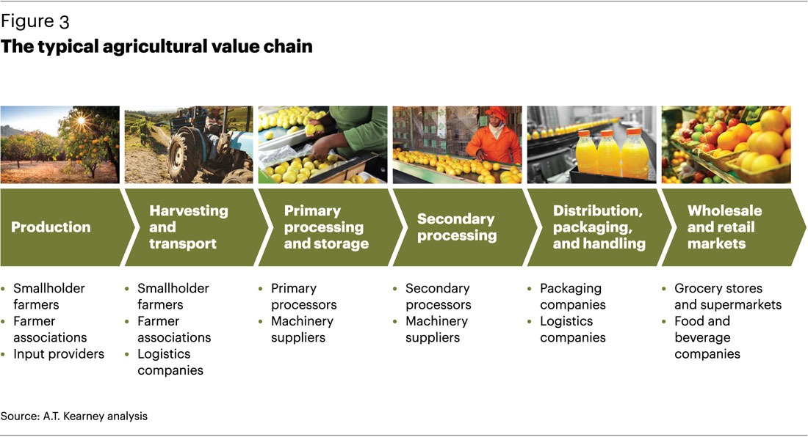
Value chains in agriculture/food systems
In LMICs there are a range of food value chains
-more simplified value chains in rural areas
-more complex value chains in urban areas
Notes:
https://www.techgistafrica.com/business/agribusiness-how-technology-is-transforming-supply-chains/

Slide 53
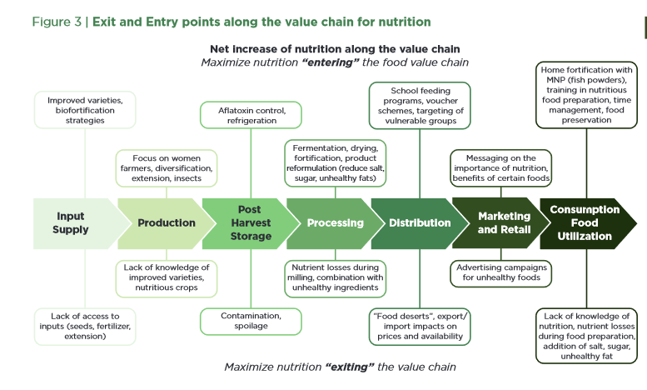
Challenges for nutrition along food value chains
Good Nutrition: Perspectives for the 21st Century
Downs and Fanzo: https://www.karger.com/Article/Pdf/452374
Notes:
https://www.karger.com/Article/Pdf/452374

Slide 54
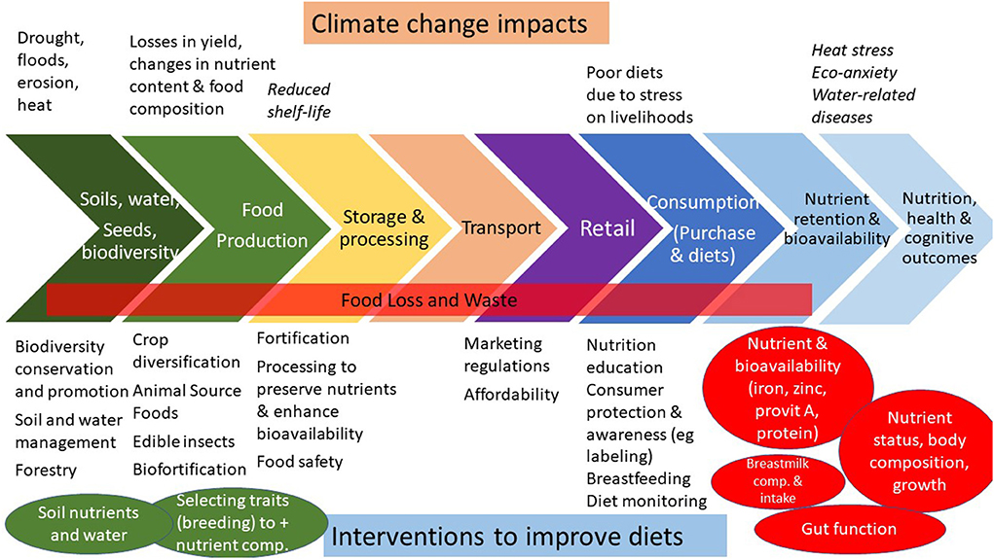
Owino et al, 2022
Notes:
https://www.frontiersin.org/articles/10.3389/fclim.2022.941842/full

Slide 55
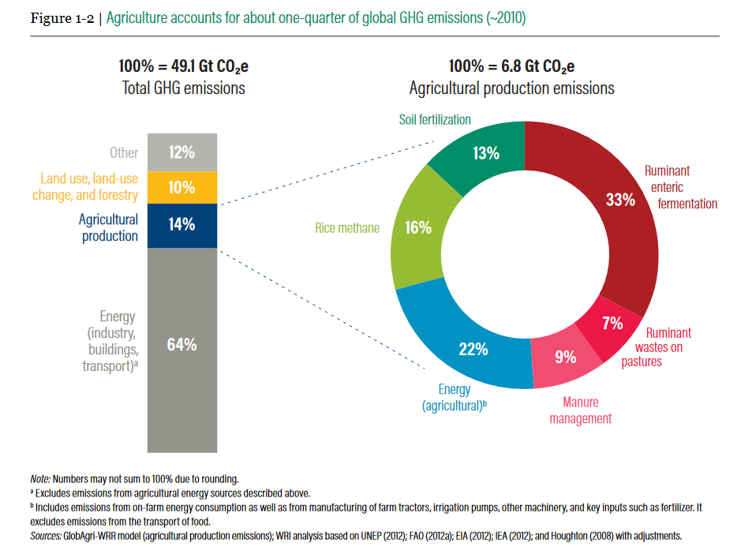
Agriculture accounts for ¼ of global Green House Gas emissions
37% of earth’s landmass (excluding Antarctica) is used for food production
Notes:
https://research.wri.org/sites/default/files/2019-07/WRR_Food_Full_Report_0.pdf

Slide 56
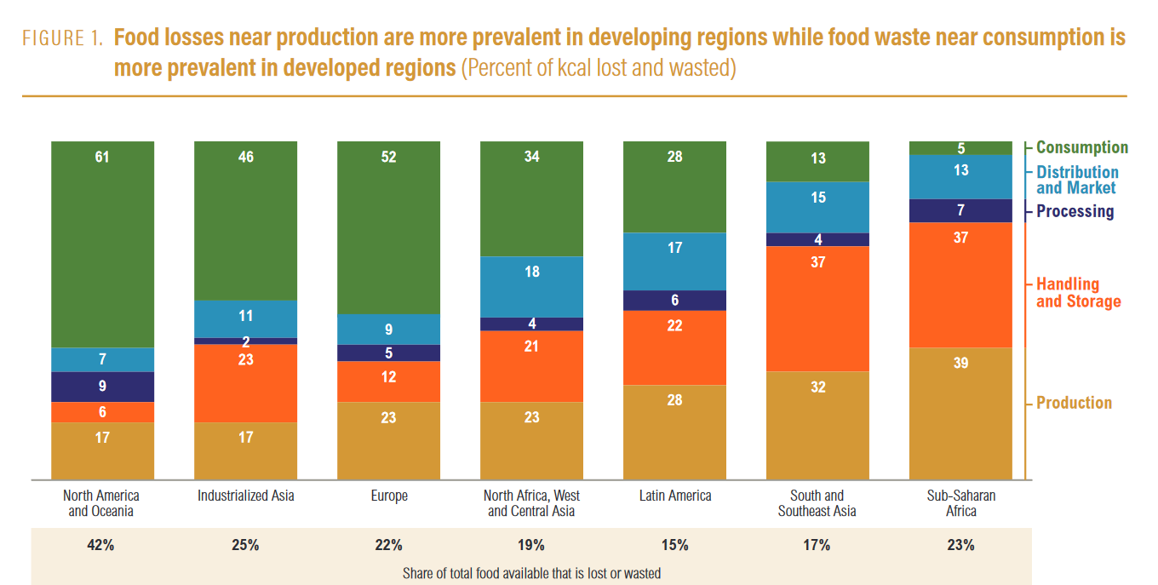
Food losses near production are prevalent in LMICs and food waste near consumption is prevalent in industrialized nations
12.3 Sustainable Development Goals (SDGs): 50% reduction by 2030 of per capita global food waste - at retail and consumer levels and reduction of food losses along production and supply chains, including post-harvest losses.
Notes:
https://www.rockefellerfoundation.org/wp-content/uploads/SDG-Target-12.3-on-Food-Loss-and-Waste_2017-Progress-Report.pdf

Slide 57
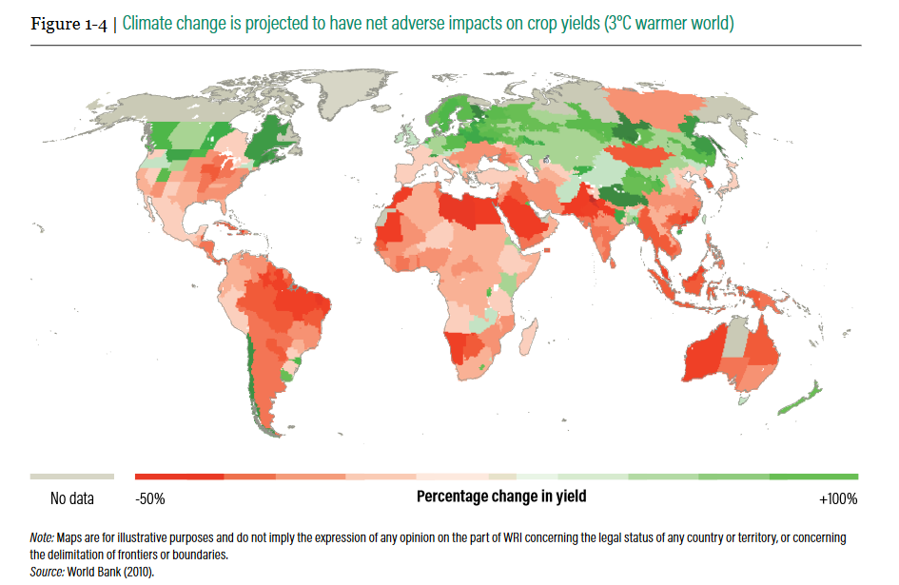
Projected impacts of changes in temperature by 3 degrees Celsius on global food production – yields could decline significantly in LMICs
https://research.wri.org/sites/default/files/2019-07/WRR_Food_Full_Report_0.pdf
Notes:
https://research.wri.org/sites/default/files/2019-07/WRR_Food_Full_Report_0.pdf

Slide 58
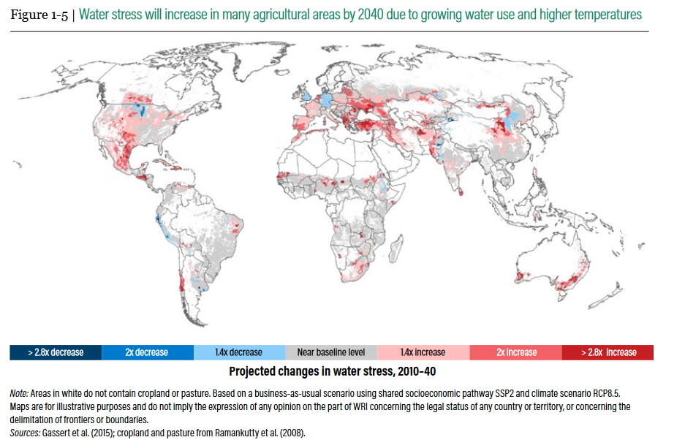
Water stress will increase in many agricultural areas by 2040 due to growing water use and higher temperatures
www. research.wri.org
Notes:
https://research.wri.org/sites/default/files/2019-07/WRR_Food_Full_Report_0.pdf

Slide 59

Fanzo et al, 2021
Notes:
https://www.nature.com/articles/s41572-021-00329-3

Slide 60

Issues: Bidirectional relationship between agriculture and environment/climate change
Notes:
https://www.annualreviews.org/doi/10.1146/annurev-publhealth-031816-044356?url_ver=Z39.88-2003&rfr_id=ori%3Arid%3Acrossref.org&rfr_dat=cr_pub++0pubmed

Slide 61
Question 4
Given concerns about the environmental impact of animal-source foods (ASF), should LMICs recommend ASF for complementary feeding for children? Why or why not?
Yes
No
Don’t know

Slide 62

Agriculture, Food Systems and Nutrition
Address immediate causes of undernutrition
Address underlying causes of undernutrition
62

Slide 63
Some potential solutions
Owino et al, 2022
Notes:
https://www.frontiersin.org/articles/10.3389/fclim.2022.941842/full

Slide 64
Pathways from agriculture to improved nutrition
Pathways are not linear! And there are many interactions (Herforth and Jody Harris, 2014)
1. Production pathway
Improved food production can improve dietary practices through greater food consumption, dietary diversity, or nutrient intake
Food availability for household consumption, as well the price of diverse foods
2. Income pathway
Agricultural sales or income reported on expenditure can increase food-related expenditure
Increased expenditure on health care, education, clothes, and productive assets
3. Women's empowerment pathway
Increased intra-household decision making and resource allocation by women; access to assets; knowledge, preferences of women
Gender power dynamics affect women’s decision-making in intra-household resource allocation related to dietary intake
Negative impact - women's time - women spending more time in agriculture, less time for childcare, rest

Slide 65

Question 6
Which pathway from agriculture to improved diets is most important for family/small scale farmers in LMIC?
Production pathway
Income pathway
Women’s empowerment
Other
Source: CGIAR

Slide 66
ROLE OF FOOD SYSTEMS IN DIET QUALITY

Slide 67

Examples of food systems metrics
HANU Intervention: homestead production of diverse, nutrient-rich foods - vegetable seed, garden training, behavior change communication
Sample: 880 women at midline
Exposures
Food crop diversity: Sum of food groups produced by the household from 7 food groups (MDD-W) (except ASF)
Market food diversity (MFD): Diversity of foods sold in smaller local markets,10 food groups MDD-W
Median MFD calculated at the village level, from 27 key informants
Distance to market for each study household: to 2 larger markets using GPS coordinates

Slide 68




Examples of climate change and nutrition research

Slide 69
THANK YOU
Source: EAT-Lancet Commission, 2020

